Slide 1
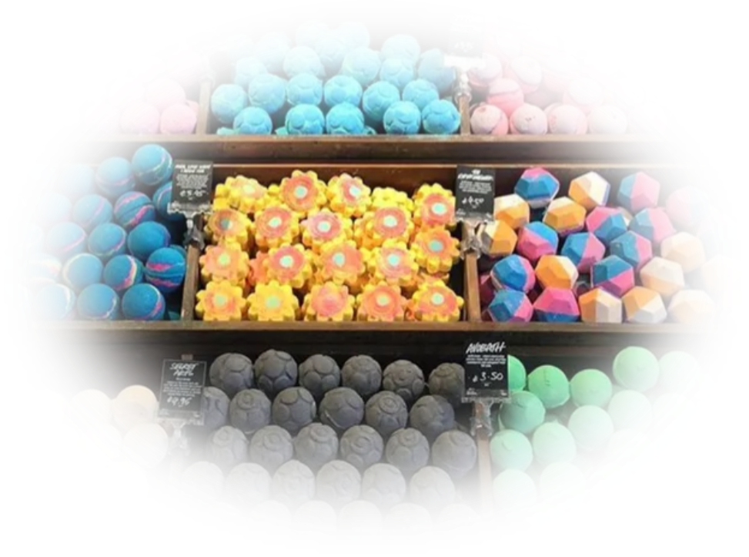
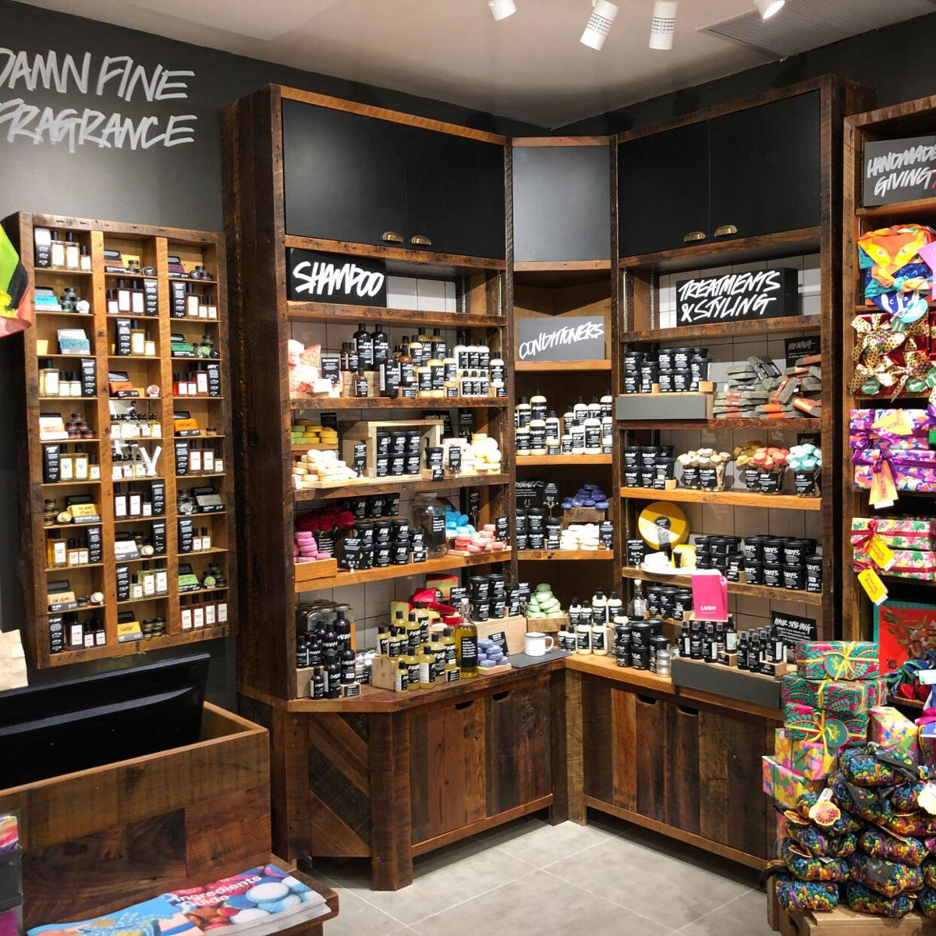
BOOSTING SALES: LUSH’S POINT OF SALES GLOW-UP!!
The Inventors of the Bath Bomb
By: Alpha Data-Developers Team with Majestic Juggernauts and Kineticism

Slide 2
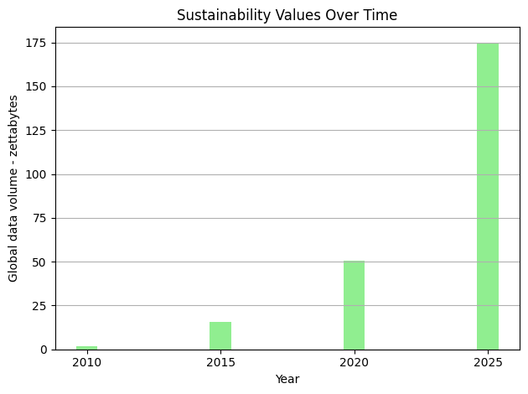

Consumer demand for sustainability
Stakeholder Expectations and Accountability
Lush’s commitment to Sustainability
Future for Sustainable growth
Notes:
Why Sustainability is Important: The rising consciousness about environmental impacts by governments has created increased consumer demand for sustainable products and services.
This impacts both internal and external stakeholders by significantly influencing companies' adherence to sustainability goals. As well as ensuring companies adopting sustainable practices are seen as having greater future value.
Lush is a perfect example, as sustainability is a clear defining feature of your business model. .

Slide 3
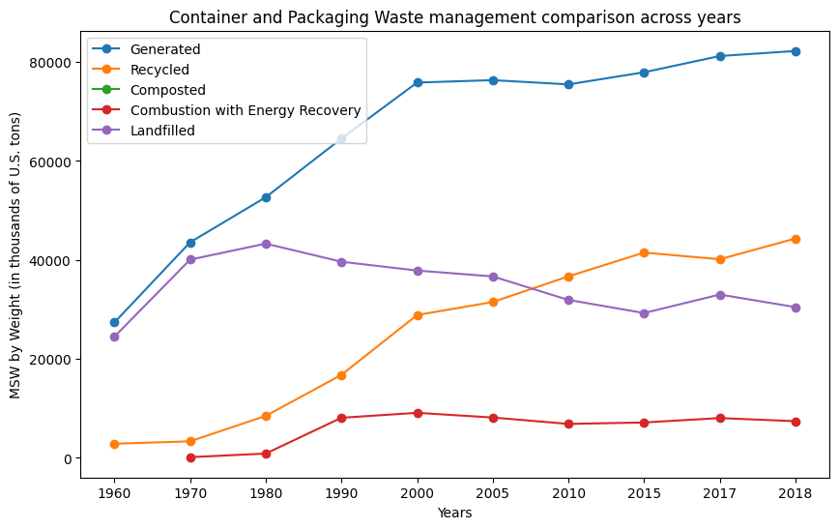
Notes:
Waste Insights
MSW- Municipal Solid Waste
the following few graphs show patterns and predictions in packaging waste
One of Lush's major values is that products should be eco-friendly and produce as little waste as possible
consider these trends in garbage management, it's clear that lush should continue to emphasize their impact on reducing waste for products, as they have become a key leader in eco-friendly packaging
plastic packaging continues to be generated as years go on, however, the percentage of packaging recycled is growing, Lush being a major driver and influence for change

Slide 4
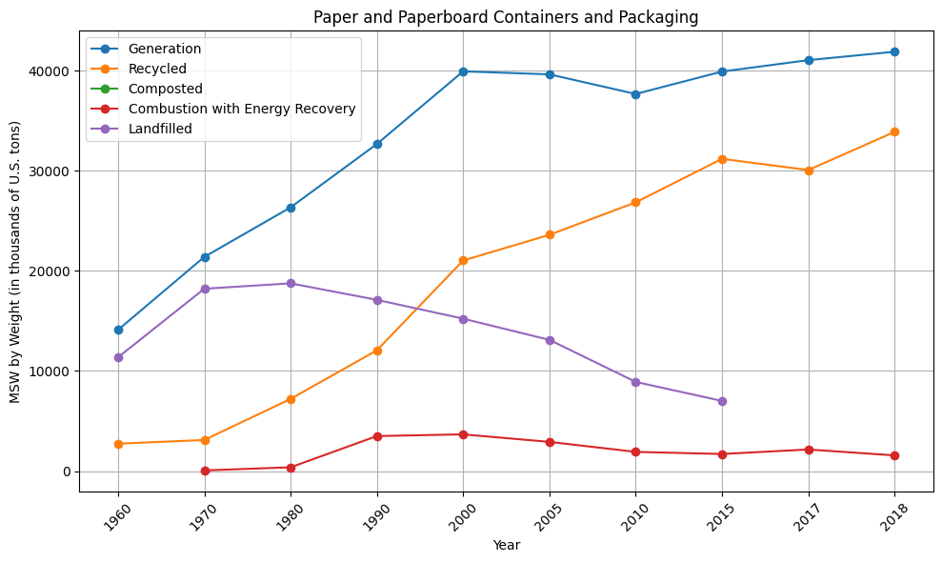

Slide 5
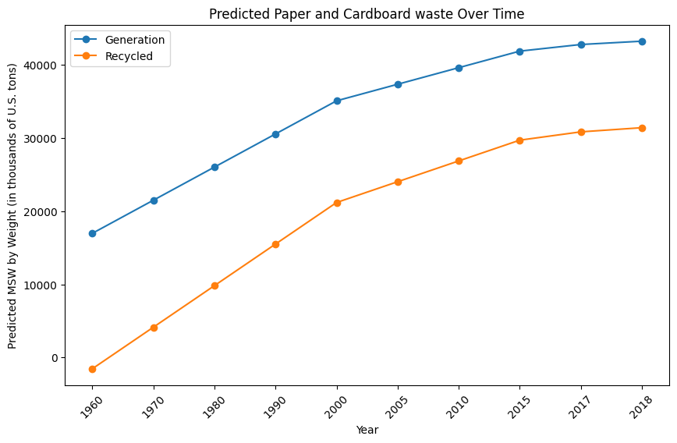

Slide 6
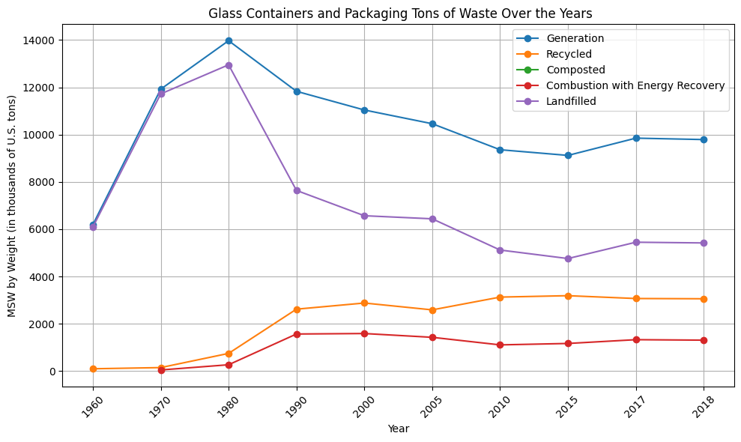

Slide 7
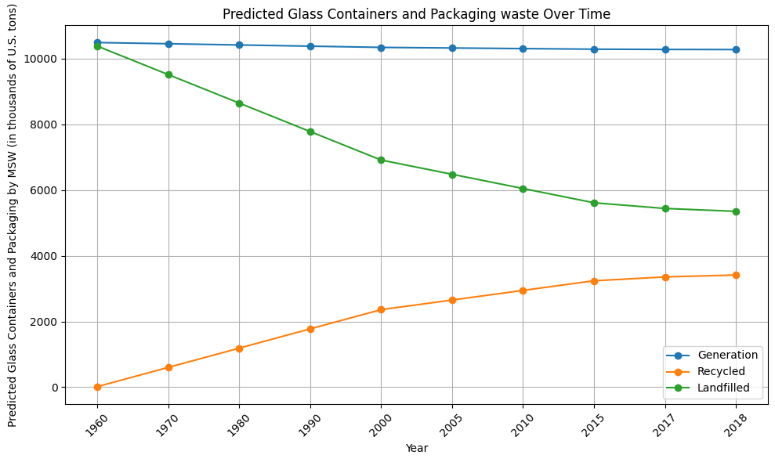
Notes:
this is good, means that less steel containers are being produced, and more are being recycled (predicted)

Slide 8
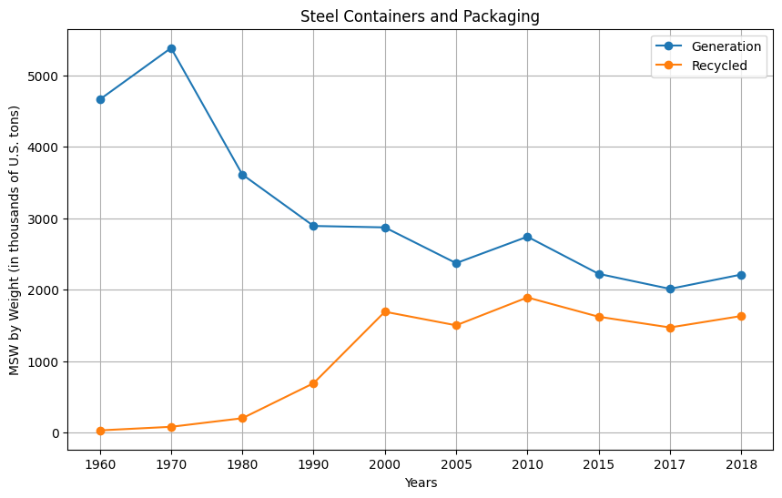

Slide 9
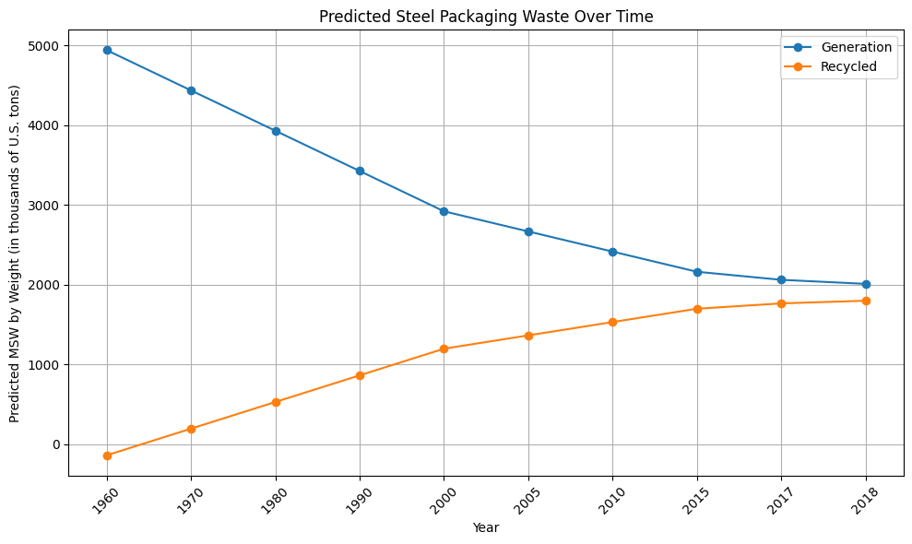

Slide 10
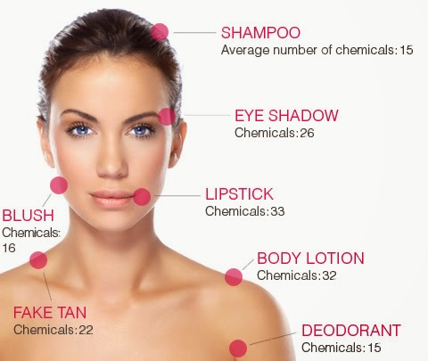

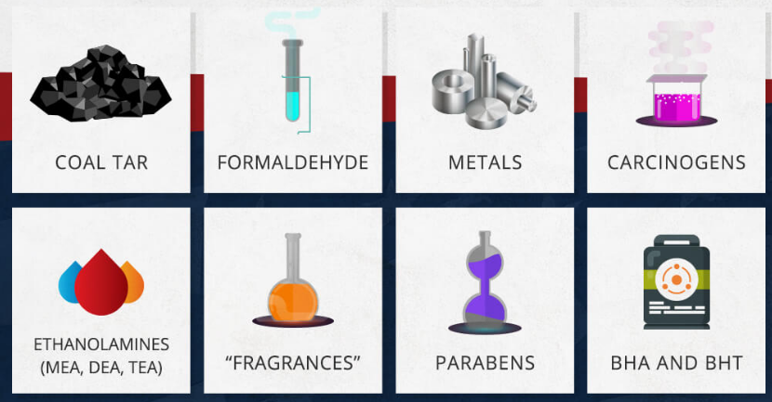
Chemicals in Cosmetics
good
bad

Slide 11
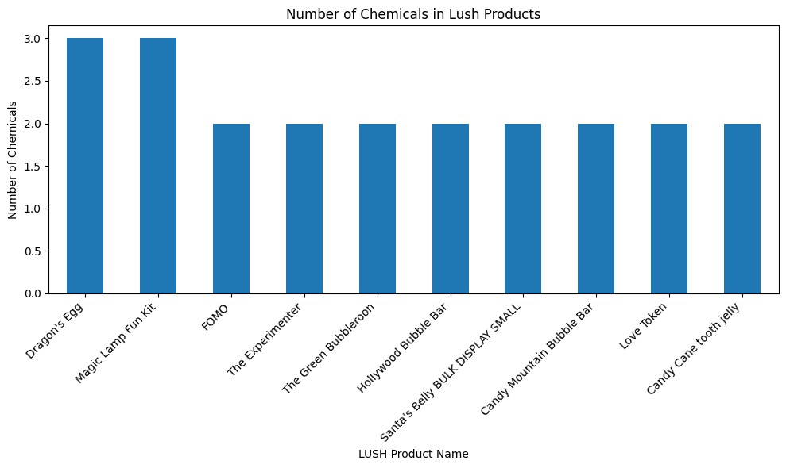
Notes:
The chemicals range for all the product from 1-9 and LUSH products have range of 2-3, meaning friendly to human and environment

Slide 12
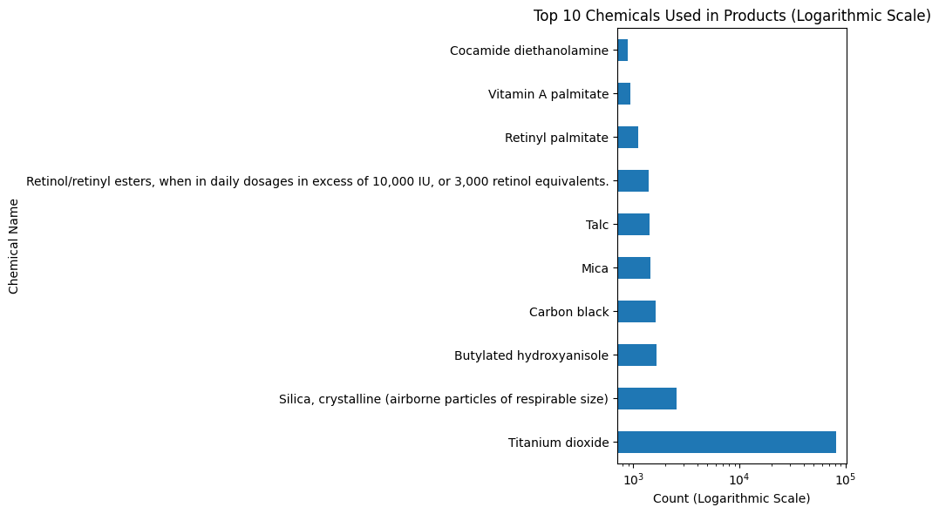
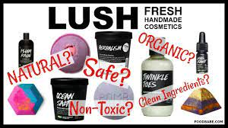
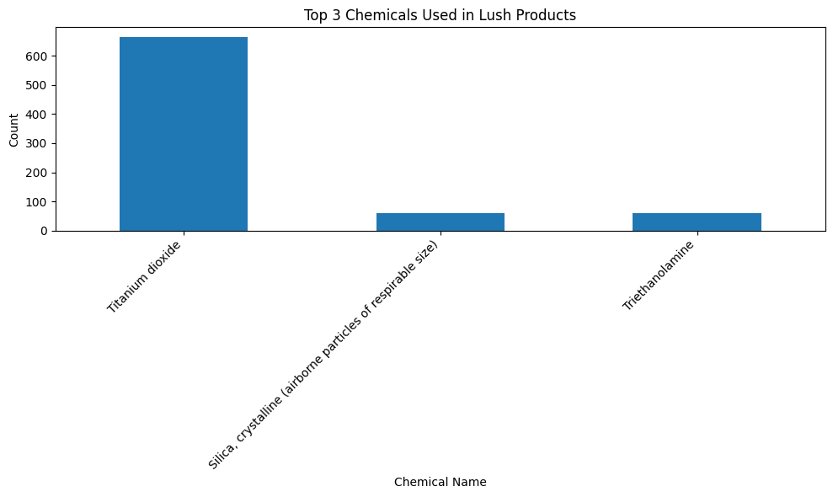
Notes:
In the range of top 10 chemical Used in Product, there are common 2 chemicals is TiO2 and Silica. That is considered safe for skin. Triethanolamine also a popular chemical is used on cosmetic industry. However, it has risk of skin irritated so it would be better to find the alternative for it.

Slide 13

Customer review insights
Notes:
Here we pulled many reviews from your US site and analyzed the most used words by customers.

Slide 14
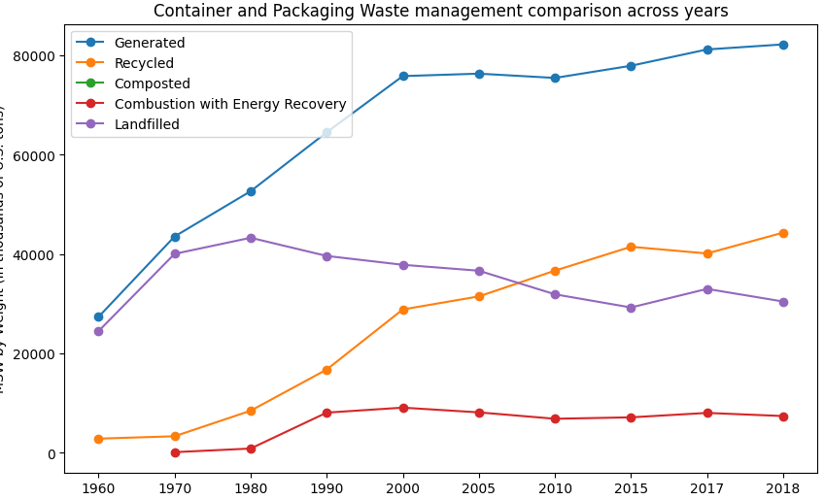
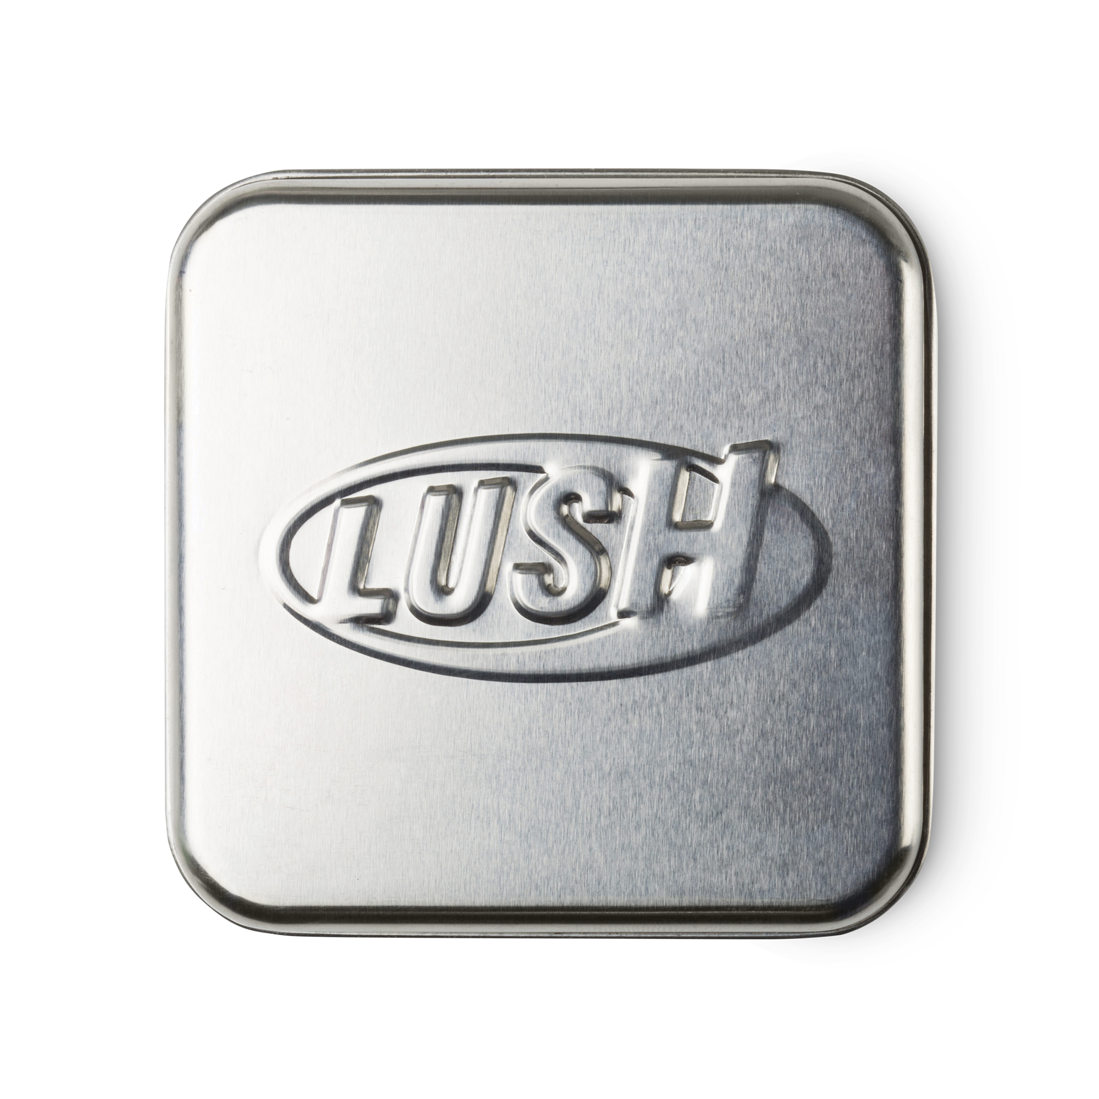
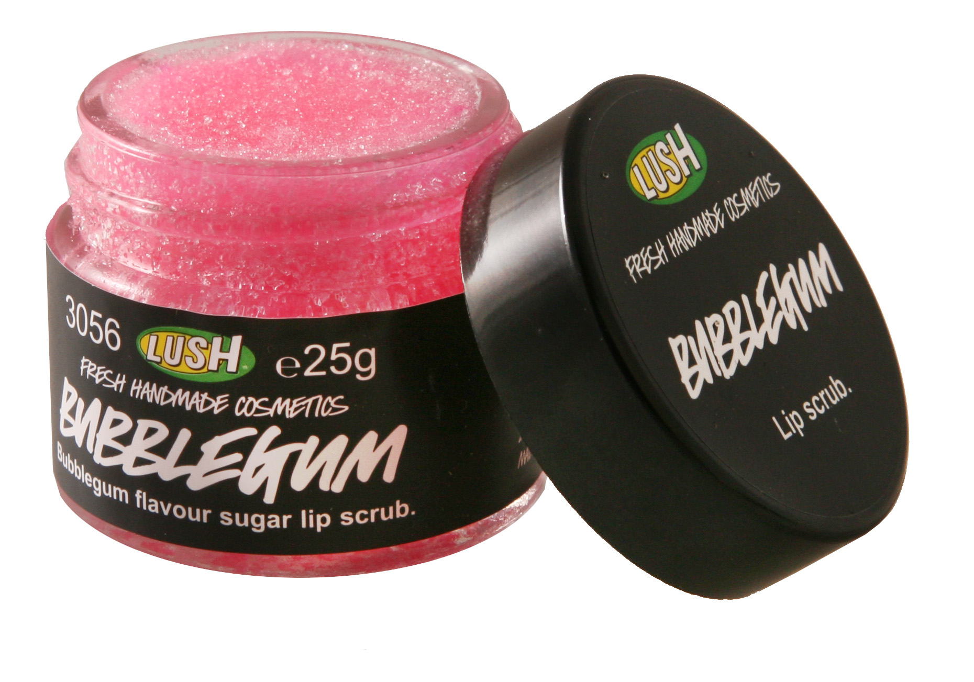
Recycled Packaging Trends
percentage change in recycling from 1960 to 2018
5333%
Steel
recycled
2960%
Glass
recycled
Notes:
The percentage change in steel recycling from 1960 to 2018 is approximately 5333.33%, taking into account the change in amount of steel generated. Following is the amount of produced glass being recycled, this has increased by 2960%

Slide 15
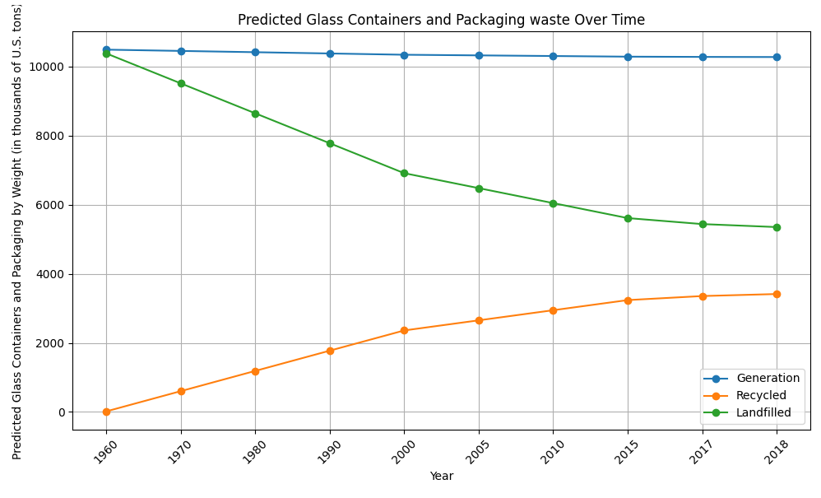
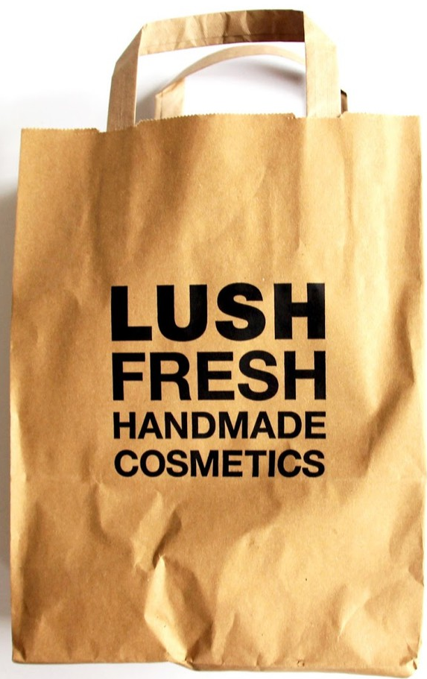
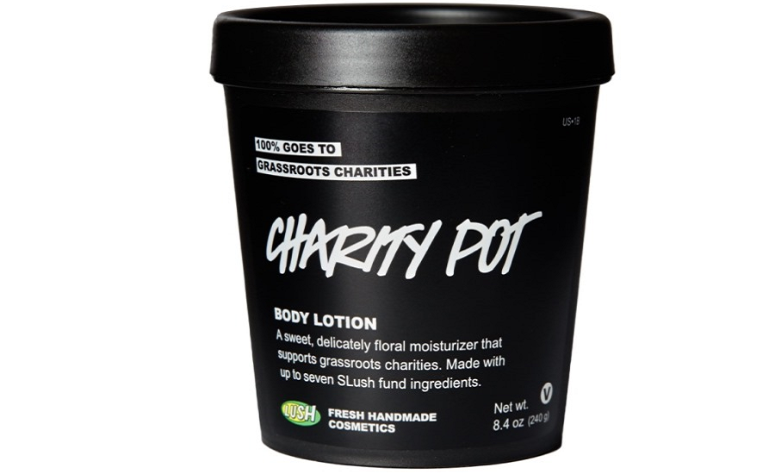
Recycled Packaging Trends
percentage change in recycling from 1960 to 2018
1440%
Plastic containers
recycled
1134%
Paper
recycled

Slide 16
Waste Insights
One of Lush's major values is that products should be eco-friendly and produce as little waste as possible, hence:
Leader in Sustainability Education
Larger proportion of material recycled
Notes:
Glass Containers and Packaging Recycling: Stable quantity over the years, with an increase in recycling and decrease in landfill disposal.
Future Prediction (1960-2018 Data): Slight increase in packaging generation expected.
Recycling and Reuse Projection: Predicts over 50% will be recycled or reused.
Landfill Impact: Remaining packaging will continue to fill landfills.
Leader in Sustainability Education
Lush should continue to emphasize their impact on reducing waste for products, as they have become a leader in making in-store recycling campaigns, and reward programs for returning packaging
Larger proportion of material recycled
plastic packaging continues to be generated as years go on, however, the percentage of packaging recycled is growing, making Lush a major influence for driving change
Known to be a sustainability trendsetter in the cosmetics market

Slide 17
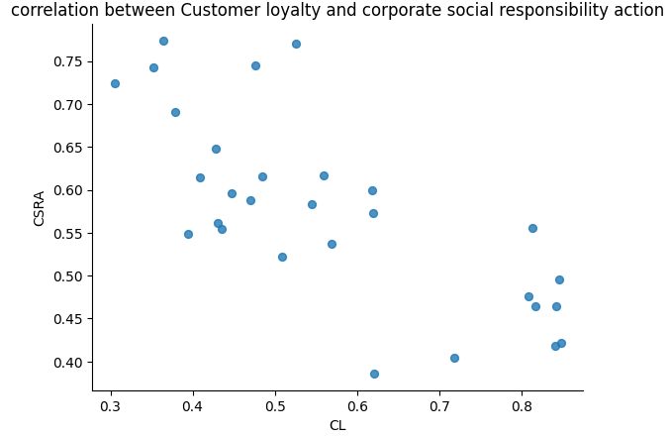
Corporate social responsibility increases customer retention
Social responsibility
Corporate credibility
Corporate image
Customer loyalty
+
retention
Notes:
How Sustainability impacts Point of Sales:
Corporate social responsibility (CSR) and it’s activities has a correlation with customer loyalty, corporate image, and corporate credibility among consumers
Key findings:
– Continuing to foster authentic corporate image through CSR activities can help LUSH enhance customer loyalty
– these insights are for corporate managers in Lush to effectively manage (increase or keep up) CSR activities and foster customer loyalty, which from glassdoor reviews -- they do

Slide 18
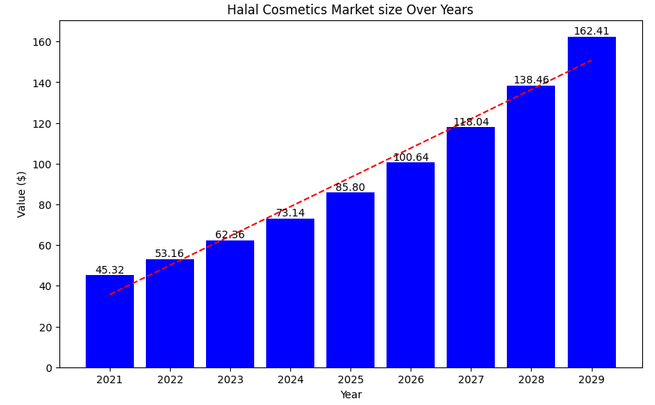
Recommendations
Percentage of surveyors who said "plastic-free" packaging influences their purchasing decisions
France
UK
Germany
85%
80%
60%
1. Consider plastic free packaging
2. Investing in Halal Cosmetics
Notes:
Halal Cosmetics
its clear there has been an increase in halal product and their demand
indicates a new avenue for lush, or suggests an increased focus on this
Use plastic free packaging
consumer purchasing behavior in France, Germany and the United Kingdom (UK) 2019 show the influence of "plastic-free" packaging in buyer preference in France, Germany and the UK. More than 80 percent of all consumers surveyed stated that the environmentally-friendly method of "plastic-free" packaging influences their purchasing decisions. Consumers are more likely to purchase products from companies if they have been produced in an environmentally-friendly way

Slide 19
References
California Department of Public Health (healthdata.gov)
https://www.verifiedmarketresearch.com/product/halal-cosmetics-market/
https://www.kaggle.com/datasets/mhapich/crueltyfree-brands
https://www.kaggle.com/datasets/kingabzpro/cosmetics-datasets
https://www.lush.com/
Contributors
Alison, Daniel, Devin, Julie, Kyle, Minh and Tiffany

Slide 20

Thanks!
any questions?

